Slide 1
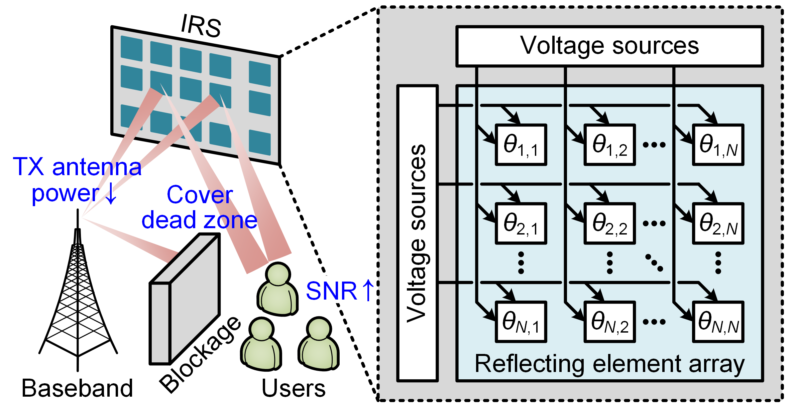
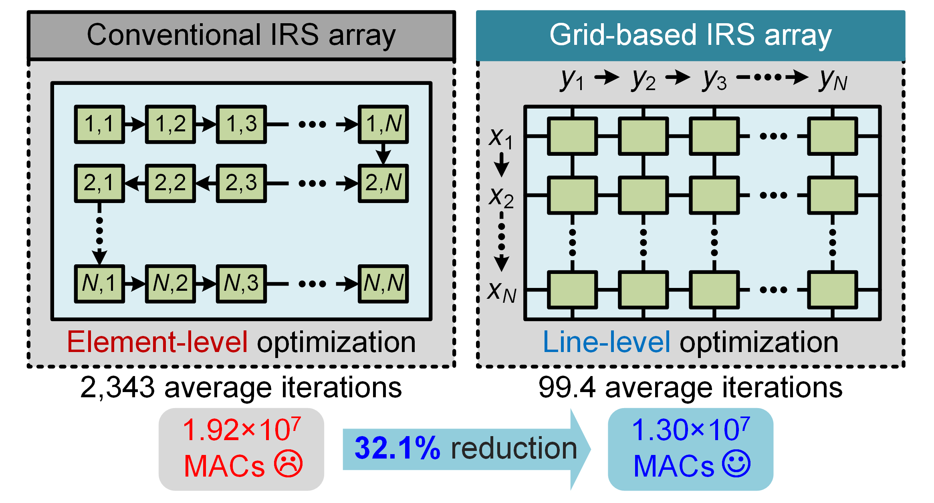
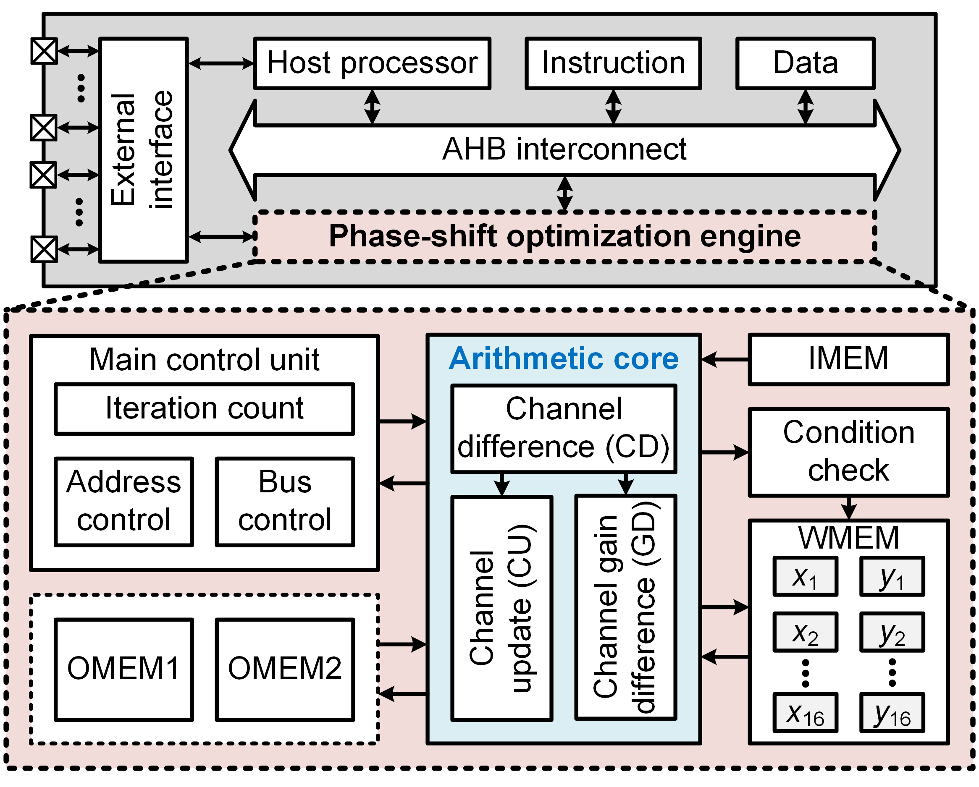
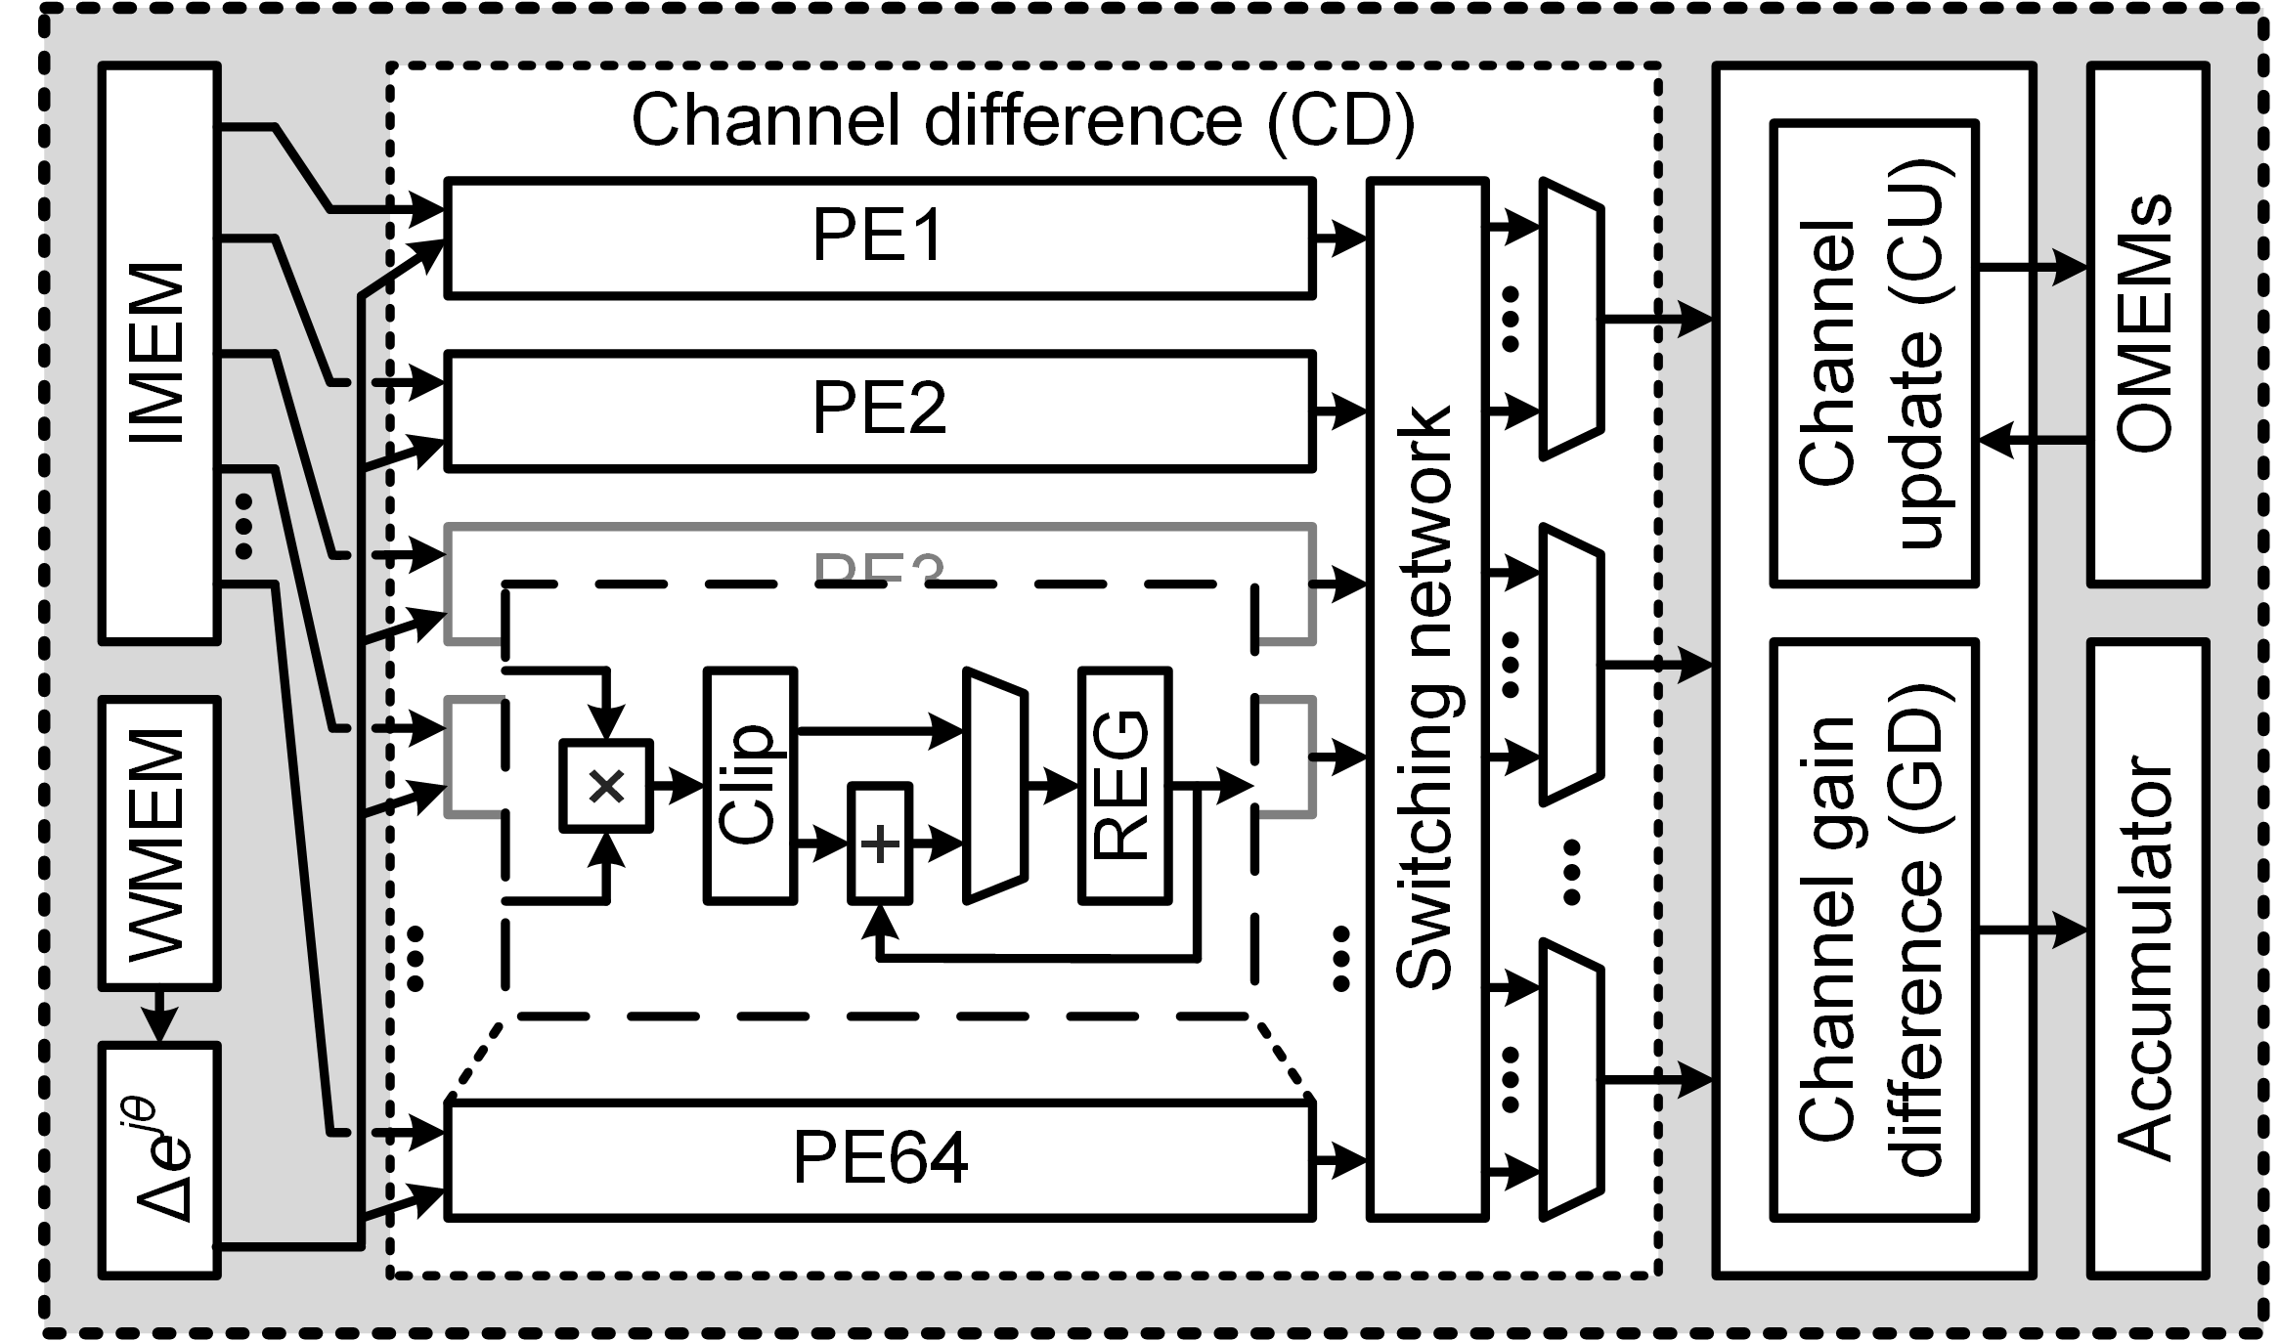
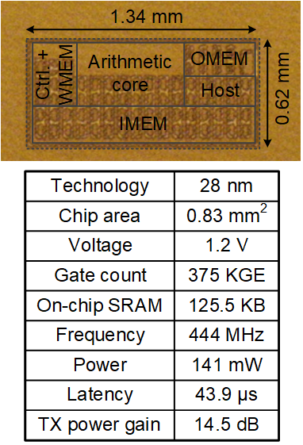
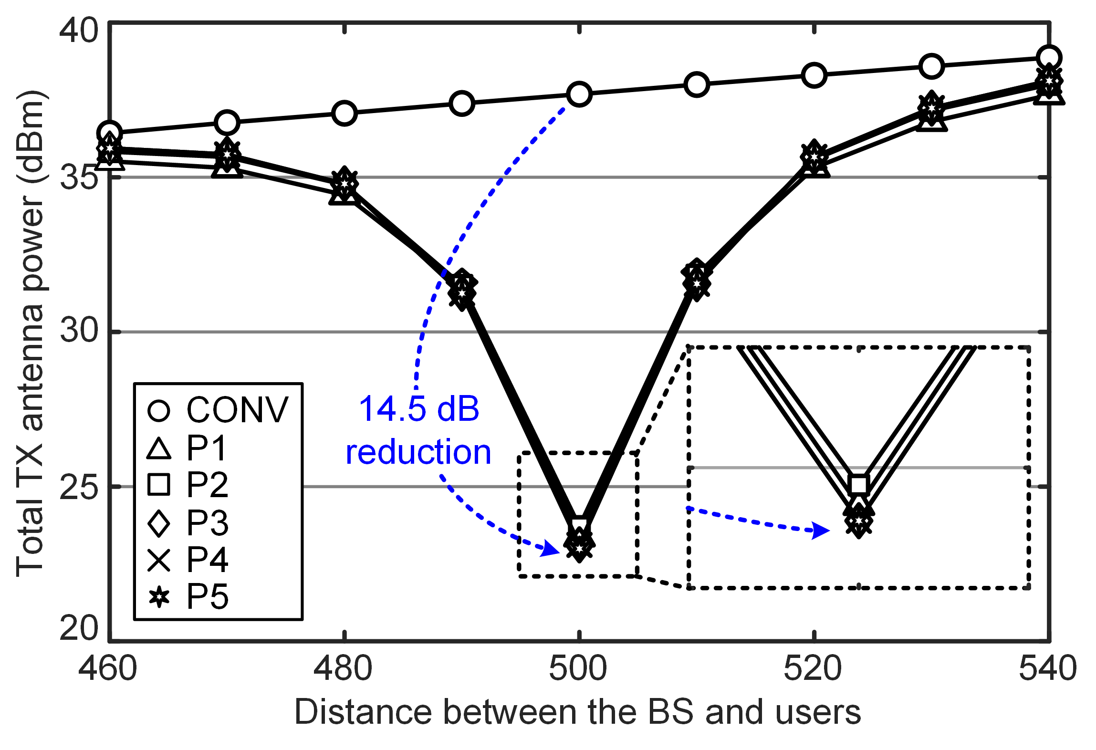
A 43.9 us IRS Controller SoC with Grid-Based
Phase-Shift Optimization in 28 nm CMOS Technology for Next-Generation Communication
Seungsik Moon and Youngjoo Lee
Department of Electrical Engineering, Pohang University of Science and Technology
Abstract
This work presents a low-latency IRS controller SoC for saving the base station (BS) TX antenna power with novel latency reduction techniques; 1) grid-based phase-shift elements with a coarse-grained update, 2) quality-aware approximate processing element with low-resolution saturation arithmetic, 3) optimized data-flow scheduling with double-buffer architecture, and 4) novel low-latency weight update tracking technique. For the 128✕8 MU-MIMO configuration with 16✕16 grid-based IRS architecture, the proposed SoC achieves 43.9 us of processing latency while saving 14.5 dB of TX antenna power.
Communication with grid-based IRS architecture
IRS-aided communication system
Grid-based IRS architecture
Proposed SoC design
System architecture
Arithmetic core
Implementation result
Performance comparison
Performance enhancement with proposed scheme
TX power reduction
Performance enhancement

